Slide 1
Manuel Gomez Rodriguez Le Song
learning.mpi-sws.org/kdd-2015-tutorial/
Diffusion in Social and Information Networks Part I
MPI for Software Systems
Georgia Institute of Technology
KDD 2015
Sydney

Slide 2
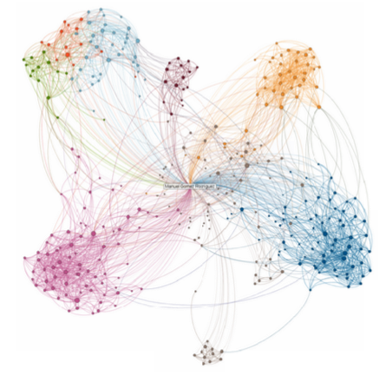
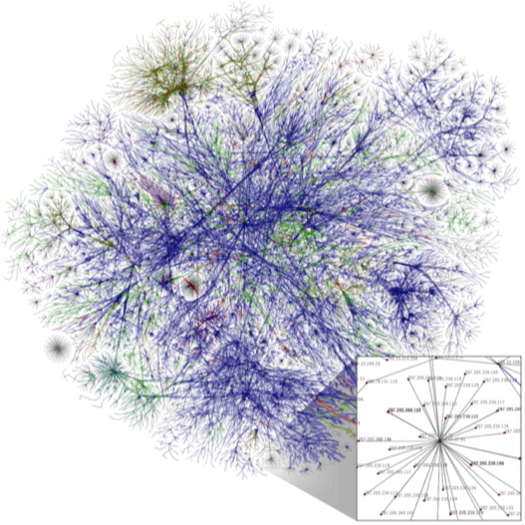
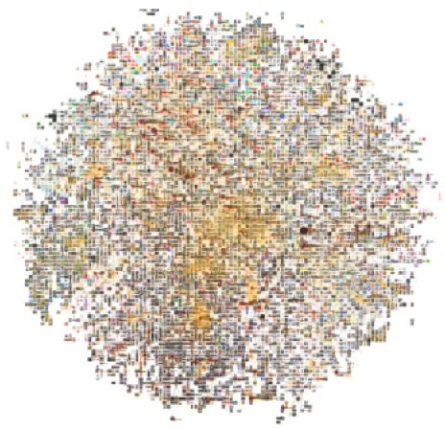
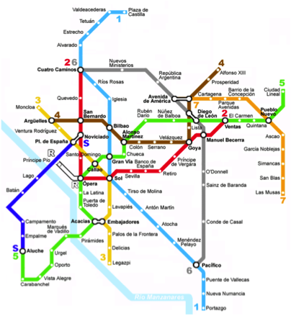
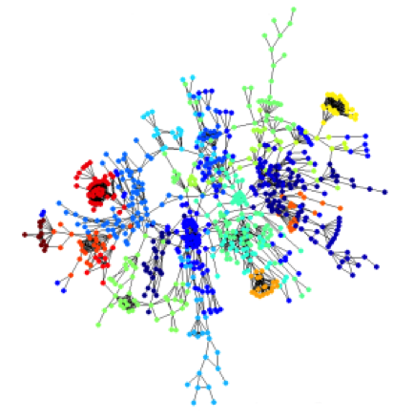
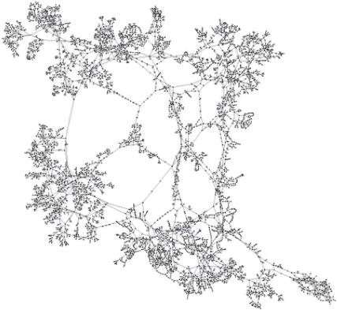
Interconnected World
Social Networks
World Wide Web
Information Networks
This tutorial
Transportation Networks
Protein Interactions
Electrical networks

Slide 3
Research on Social & Information Networks
We know a lot about network structure & network evolution:
Properties: 6-degree of separation [Milgram ‘67], weak ties [Granovetter ‘73], scale-free [Barabasi ‘99], communities [Newman et al. ‘02], densification [Leskovec et al. ’06], etc…
There has been an increasing interest in processes and activity over networks, why?
Models: Small world [Watts & Strogatz ‘98], Searchability [Kleinberg ‘00], Bowtie [Broder et al. ‘00], Random Surfer Model [Blum et al. ‘06], Kronecker graphs [Leskovec et al. ‘10], etc.

Slide 4





Unlimited Network Capacity
65M Terabytes
Worldwide telecoms
networks capacity
6 newspapers per person/day!
[Science, 2011]
400M tweets/day [2013]
700M photos & videos/day [2014]
100 hours/minute [2013]

Slide 5

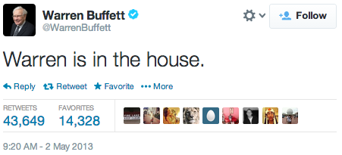
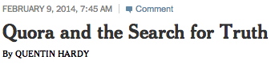
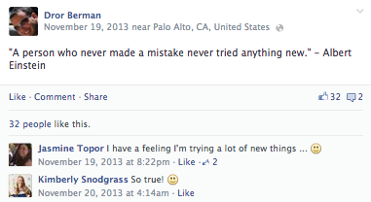
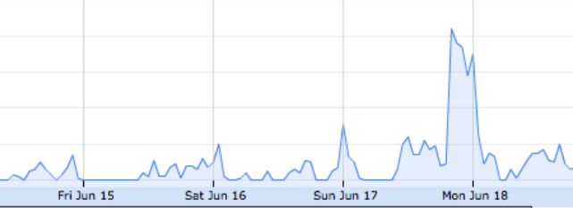
Detailed traces of activity
The availability of digital activity data enables data-driven
(machine learning) methods
Detailed Traces of Activity
#greece retweets

Slide 6
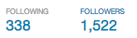

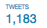
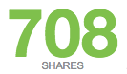
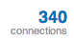
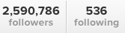
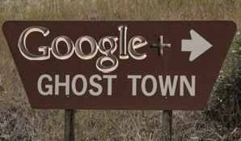
Structural vs Functional
Structural Connectivity
Functional Connectivity
Spread of contagions
# users
# active users
engagement
# connections
# active connections
influence
viral marketing
In social media
rumors
information overload
fear of missing out
What happens if the functional connectivity is missing…

Slide 7
Opportunities for Machine Learning
stochastic processes
point processes event-history analysis
high-dimensional stats
Probabilistic Models
and
Recent field, foundations are in progress. We will give you a biased glimpse of the field, but a principled one!
Learning Methods
to
Part I
understand
predict
submodular optimization
convex programming randomized methods large-scale optimization
control
Processes & Activity
over
Part II
Social & Information Networks

Slide 8
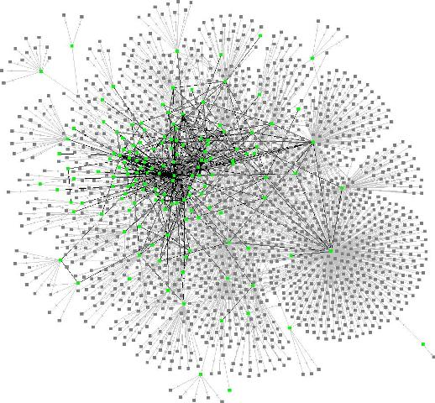
What is all about?
Stochastic processes over a large networks
Part I: Models
Part II: Learning Methods
Modeling Information Diffusion
Influence Maximization
Exact & Approx. Estimation
Approx. Maximization
Basic Cascade Model Cascades as Point Processes
Source Localization
Modeling Social Activity
Maximum likelihood
Estimation
Activity Shaping
Beyond Cascades Activity as Hawkes Processes
Beyond Influence Max
Convex Opt. Framework
Notes:
Outline of tutorial

Slide 9
Outline: Part I
Modeling Information Diffusion
Basic Cascade Model Cascades as Point Processes
Modeling Social Activity
Beyond Cascades Activity as Hawkes Processes

Slide 10


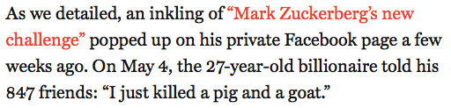

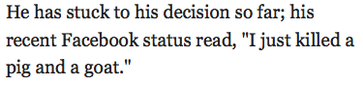
Information diffusion as cascades
Node
i
Meme
Node
j
t_{i}
Meme
Node
k
t_{j}
Meme
t_{k}
t

Slide 11
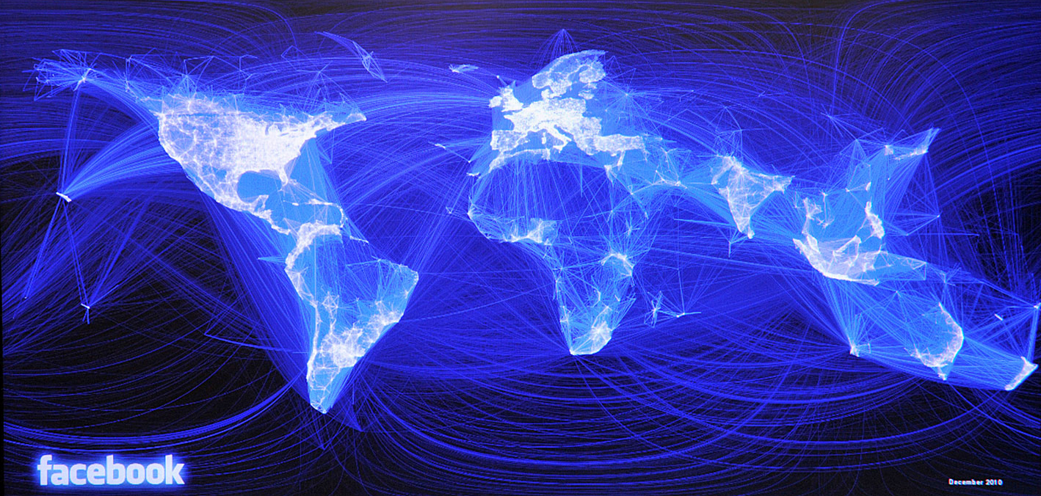



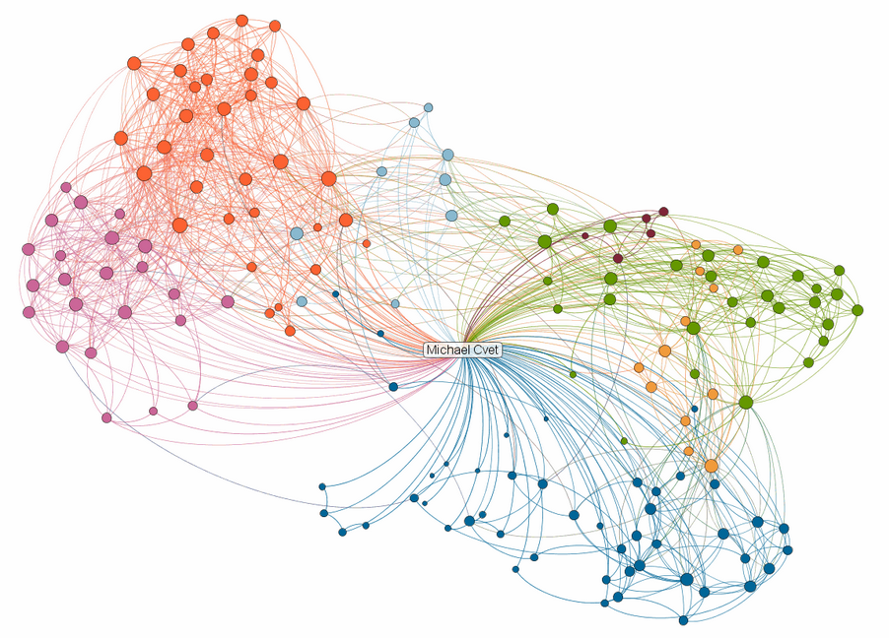

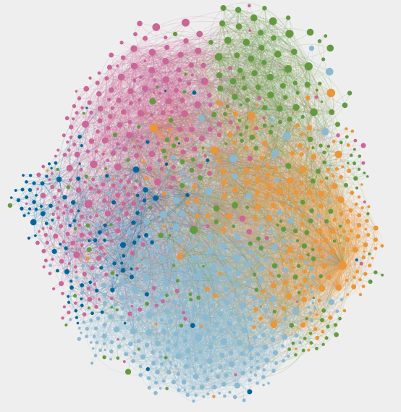
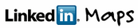
Structural network may or may not be there
Structural network explicitly exists in social networks:
Structural network often does not exists in the Web:
If the structural network exists, it constrains the functional network
Read by thousands bloggers, without explicitly following

Slide 12

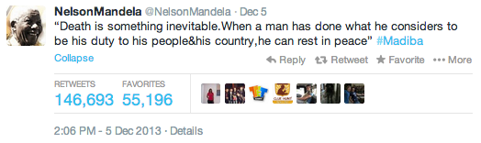


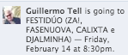
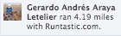
Spread of Contagions in Functional Networks
Functional networks provide a skeleton for the spread of contagions, like, information, ideas, products, and behaviors.

Slide 13

Some nodes are fast, others are slow
“I just killed a pig and a goat”
Mark Zuckerberg

Slide 14
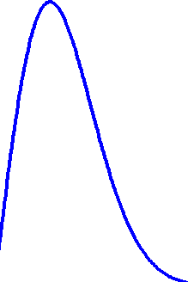
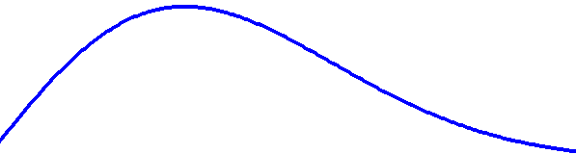
Timing tells influence pattern
It defines a transmission delay Δ_{ji} per edge:
Transmission likelihood (PDF)
Δ_{ji} ~ f(Δ_{ji} ; α_{ji})
t_{j}
t_{i}
j
i
Transmission rate α_{ji} models how quickly diffusion occurs:
f(Δ_{ji} ; α_{ji})
f(Δ_{ji} ; α_{ji})
Δ_{ji}
Δ_{ji}
small α_{j,i}
longer delays
big α_{j,i}
shorter delays

Slide 15
Why not discrete-time
Transmission
probability
β_{ji}
j
i
Discrete time-models artificially introduce epochs:
t_{h}
t_{i}
t_{j}
t_{k}
t_{l}
t_{m}
t_{n}
Epoch 1
Epoch 2
Epoch 3
Epoch 4
1. How long is each epoch?
4. Difficult to fit from real data
2. How do we aggregate events within a epoch?
3. What do we do if there is not data within a epoch?

Slide 16
Functional Network Inference
Information propagates on a directed functional network at different transmission rates:
Cascade 1
Cascade 2
The aim is to infer the functional network and their transmission functions only from cascades
Source 1
Source 2
We do not observe edges nor transmission functions, only when a cascade reaches a node.
[Gomez Rodriguez et al., KDD 2010]

Slide 17
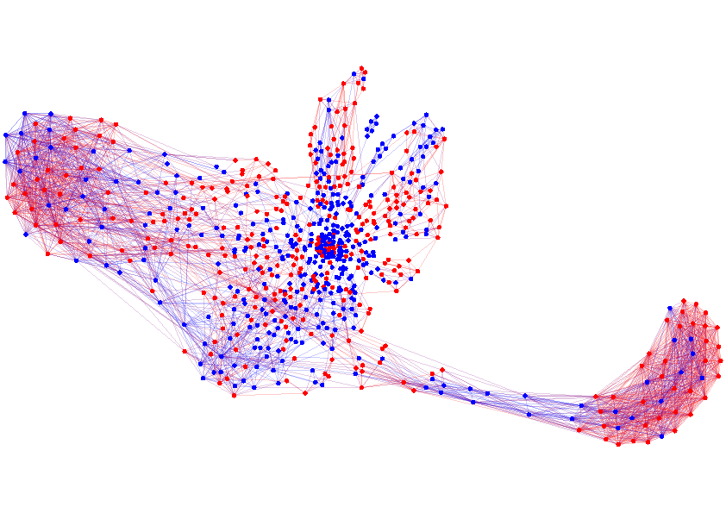
Network Inference as Maximum Likelihood
j
i
Pairwise interactions
t_{j}
t_{k}
t_{l}
t_{i}
Cascade
Network
Transmission functions
Likelihood of the observed data
Maximum likelihood solution
Δ_{ji} ~ f(Δ_{ji} ; α_{ji})
f({t_{j}} ; {α_{ji}})
max_{{αji}} Σ_{c} log f({t_{j}}^{c} ; {α_{ji}})
[Gomez Rodriguez et al., ICML 2011]

Slide 18
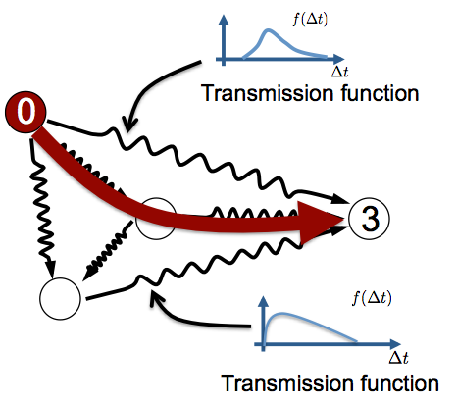
Cascades across the network
Network with stochastic edge weights
Infection time t_{i} = length of shortest path
Assumption: there is an observation window T, and any time t_{i} > T is not observed.

Slide 19
Diffusion between two nodes
Remember: we define a transmission delay Δ_{ji} per edge:
Transmission likelihood (PDF)
Δ_{ji} ~ f(Δ_{ji} ; α_{ji})
t_{j}
t_{i}
j
i
The aim is to infer the transmission rate α_{j,i}. If α_{j,i} > 0, there is functional edge (j, i)

Slide 20
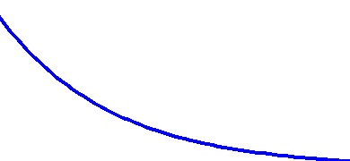
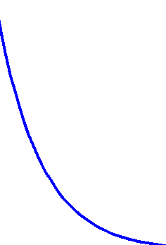
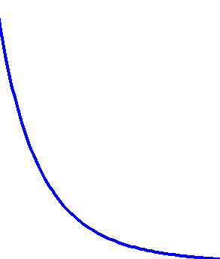
Parametric transmission likelihoods
Different parametric forms for the transmission likelihood:
Exp
Social and Information Diffusion Models
Pow
Epidemiology
Ray
t_{j}-t_{i}
t_{j}-t_{i}
small α_{j,i}
big α_{j,i}
As α_{j,i} 0, likelihood 0 and E[tx time] ∞

Slide 21
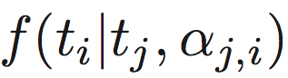
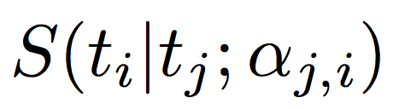
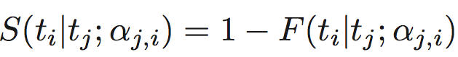
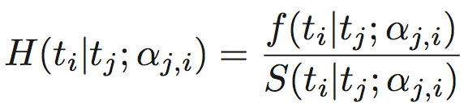
Survival and Hazard
The survival function of edge is the probability that node is not activated by node by time t_{i}:
j
i
i
j
t_{j}
t_{i}
The hazard function of edge is the likelihood that node is activated by node by time t_{i} given that it survived until t_{i}:
j
i
i
j

Slide 22
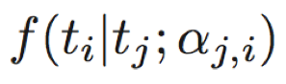
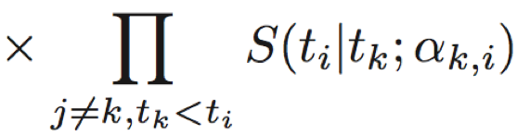
Activation of a node by multiple nodes
t_{j}
t_{k}
t_{l}
t_{i}
activation times
Cascade
A node gets activated once the first parent activates it.
i
i
Remember: Shortest path
j
k
l
f(Δ_{ji} ; α_{ji})
j
i
f(Δ_{ki} ; α_{ki})
k
i
f(Δ_{li} ; α_{li})
l
i
×
×
t_{j}
t_{i}
Δ_{ji}
t_{k}
t_{i}
Δ_{ki}
t_{l}
t_{i}
Δ_{li}

Slide 23
Likelihood of activation of a node
We need to consider each parent to be the first parent
t_{j}
t_{k}
t_{l}
t_{i}
activation times
Cascade
i
l
×
×
+
j
k
t_{j}
t_{i}
t_{k}
t_{i}
t_{l}
t_{i}
Δ_{ji}
Δ_{ki}
Δ_{li}
i
l
×
×
+
j
k
t_{j}
t_{i}
Δ_{ji}
t_{k}
t_{i}
Δ_{ki}
t_{l}
t_{i}
Δ_{li}
i
l
×
×
j
k
t_{j}
t_{i}
Δ_{ji}
t_{k}
t_{i}
Δ_{ki}
t_{l}
t_{i}
Δ_{li}

Slide 24
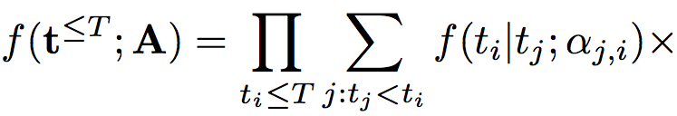
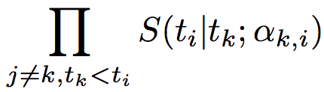
Likelihood of a cascade
The likelihood of the activations in a cascade is:
j
Source
i
l
1st infection
2nd infection
3rd infection
k

Slide 25
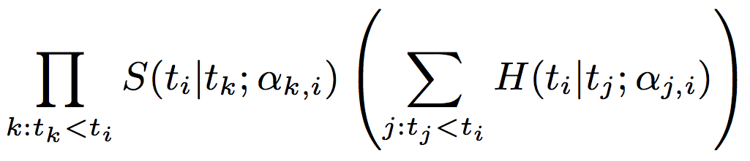
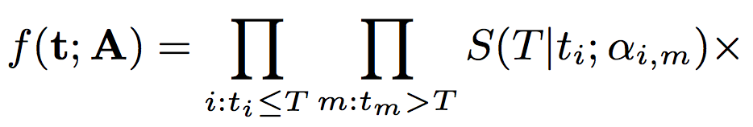
Likelihood of a cascade
The likelihood of (the activations and non-activations in) a cascade by time T is:
Non activated nodes
Activated
nodes
Survival functions
Survival & hazards functions

Slide 26
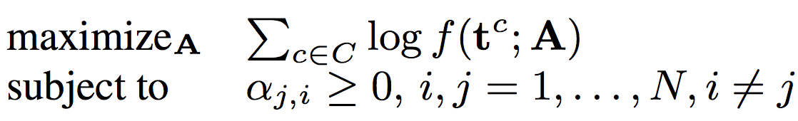
Convex Maximum Likelihood
Cascades likelihood
Theorem. For a large class of transmission likelihoods, the network inference problem
is parallelizable, convex & consistent in A.

Slide 27
How do we do in theory?
The network inference problem is convex & consistent in A, what does it mean?
Perfect recovery if the # of cascades n ∞, what if n < ∞?
The optimal rates Â are unique & can be found efficiently (run-time & memory usage)
If the number of cascades goes to ∞, then Â = A (perfect recovery!)

Slide 28
Optimality with finite number of cascades
Can we recover a network from a few cascades in theory? If so, how many?
Under some conditions, it can, as long as we observe O(d_{max}³ log N)
The actual proof of sample complexity is challenging
j
Maximum In-degree
Number of Nodes
i
k
l
Positive (sample complexity) result: million (or billion) of nodes, but maximum in-degree will be small in comparison.
[Daneshmand et al., ICML 2014]

Slide 29

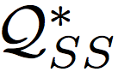
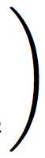
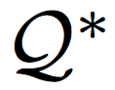
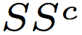
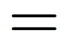
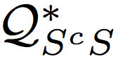



Incoherence Condition
Idea: a node and any of its neighbors should get activated together in a cascade more frequently than the node and non-neighbors
Between parents
Between non-parents
Between parents & non-parents

Slide 30





Incoherence Condition: Examples
Incoherence condition depends on network structure, transmission rates, source distribution & observation window:
0
1
2
3
α₀₁
α₁₂
α₂₃
T ∞
2
α₀₂
1
T < ∞
0
α₀₁
α_{0p}
p
T ∞

Slide 31

Querying from the Model
Exact analytical queries from the model often require some specialized machinery. For example,
t_{n}
Other learning problems require other queries. More about this in part II!
Source
t_{A} = 0
t_{A} = 0
Sink (node n)
generator matrix from a CMTC on a state space computed from the network structure
and the transmission rates.

Slide 32






Multimodal Transmission Functions
We define a transmission delay Δ_{ji} per edge:
Transmission likelihood (PDF)
Δ_{ji} ~ f(Δ_{ji})
j
i
Memetracker data:
$$Δ$$
$$Δ$$
$$Δ$$
Pair 1
Pair 2
Pair 3

Slide 33
Nonparametric hazard functions
Nonparametric estimation of the hazard function:
The network inference problem is still convex!
t_{i}-t_{j}
k(τ, t_{i}-t_{j})
k(τ, t_{i}-t_{j}): Gaussian RBF kernel
τ₁
τ₂
τ₃
τ₄
τ₅
τ₆
τ₇
T
t_{i}-t_{j}
[Du et al., NIPS 2012]

Slide 34

Topic-sensitive Transmission Functions
We define a transmission delay Δ_{ji} per edge:
Transmission likelihood (PDF)
Δ_{ji} ~ f(Δ_{ji} ; α_{ji}, m)
j
i
Memetracker data:

Slide 35


Topic-sensitive hazard functions
Topic-modulated hazard function:
The network inference problem is still convex!
LDA weight for topic l
[Du et al., AISTATS 2013]

Slide 36
Time-varying transmission functions
In some cases, networks and dynamics change over time:
#greece retweets
0
T
Propagation over dynamic networks with variable transmission rates

Slide 37

Time-varying transmission functions
We penalize older cascades in the maximum likelihood estimation:
The network inference problem is still convex!
Tradeoff:
Tracking changing transmission rates fast requires forgetting old cascades quickly
Forgetting old cascades too quickly results in less reliable estimates
[Gomez-Rodriguez et al., WSDM 2013]

Slide 38
How do we do in practice?
Generate Kronecker/Forest Fire networks
Generate cascades using the model
Apply maximum likelihood to recover the networks
✔
Accuracy (connectivity)
✔
MAE (transmission rates)

Slide 39






Synthetic Networks: connectivity
Hierarchical Kronecker, Exp
Forest Fire, Pow
Random Kronecker, Ray
1,024 node networks with 5,000 cascades

Slide 40


Synthetic Networks: tx rates
Three types of (1,024 nodes, 2,048 edges) Kronecker networks and a (1,024 nodes, 2,422 edges) Forest Fire network with 5,000 cascades (optimization over 1,024 x 1,024 variables!)

Slide 41



Network Inference on the MemeTracker Dataset
A meme is an idea, behavior, or style that spreads from person to person within a culture [Merriam-Webster].
172 million news articles over a year >300 million short textual phrases
MemeTracker Dataset:
It traces the flow of information using short textual phrases that travel through the Web, which act as tracers for memes [Leskovec et al., KDD ‘09].
“Fukushima, March 12, 15.36: the end of the nuclear age”
“I just killed a pig and a goat”
“You can put lipstick on a pig, but it’s still a pig”

Slide 42

Cascades: Spatiotemporal Traces of Memes
[Leskovec et al., KDD ’09]
A cascade c_{m} is simply a record of the times when sites first mentioned meme m.

Slide 43
How well does network inference work with real data?
✔
1. Sanity check with hyperlink network
>40% overlap between inferred (meme-based) network and hyperlink network
2. Prediction task
predict
predict cascade size, cascade duration & actual nodes
3. Data insights
understand
underlying structure & dynamics of information diffusion
position & roles nodes in the network play

Slide 44


Real Networks: Prediction Task
Average F1-score vs cascade size
Matching a particular cascade is difficult, it is a probabilistic process.

Slide 45

Diffusion Network (small part)
Blogs
Mainstream media

Slide 46
Observation I: Events
Youtube video: http://youtu.be/hBeaSfRCU4c

Slide 47
Observation II: Dynamic Clusters
Youtube video: http://youtu.be/hIeF9NMSCLo

Slide 48
Observation III: Social Capital
Youtube video: http://youtu.be/yLgiGqpiM64

Slide 49


Observation IV: population wide event
Civil war in Libya
Syria’s uprise
News are sometimes spreading earlier among blogs than mass media, often when civil population is involved, as the civil war in Libya or Syria’s uprise.

Slide 50

Observation V: centrality
NBA
Occupy Wall Street
The distribution of mainstream media and blogs among the most central sites can be relatively steady (NBA) or more time-varying (Occupy Wall Street).

Slide 51
Outline
Modeling Information Diffusion
Basic Cascade Model Cascades as Point Processes
Modeling Social Activity
Beyond Cascades Activity as Hawkes Processes

Slide 52



Beyond Cascades
Up to this point, we have assumed we can map each event to a cascade
All is not so clear as:
“I just killed a pig and a goat”
In general, especially in social networks:
Difficult to distinguish cascades in event data
Most cascades are single nodes (or forests)
no likes
no comments
no shares

Slide 53



Information diffusion as counting process
For each cascade and node , we have a counting process
i
N_{i}
By definition, the counting process is non-decreasing
1 (Activated)
0 (Non Activated)
t_{i}
Zero mean martingale
Conditional intensity function
Hazard
function
[Gomez Rodriguez et al., ICML 2013]

Slide 54

















Users’ events as counting processes
We model each user’s events as a counting process N(t):
Example: to keep it simple, events are only tweets & retweets, but in reality, events can be any action (likes, replies, etc.)
N(t)
N(t)
t
N(t)
t
N(t)
t
N(t)
t
t

Slide 55




Exogenous vs endogenous activity
Exogenous activity Users’ actions due to drives external to the network
Endogenous activity Users’ responses to other users’ actions in the network
Relationship to cascades
.
..
These are the cascade sources!

Slide 56






Cascade view of exogenous vs endogenous
Social network
Social activity
Exogenous events
Endogenous events
All events
(tweets)
(retweets of tweets)
(retweets of retweets)

Slide 57

Counting processes & user’ events intensity
Increase in # of events (tweets)
from t to t+dt
We do not assume independent cascades, as before!
Instantaneous events intensity (tweets / hour)
Instantaneous rate or frequency
History of tweets
up to t
Key idea The counting process has memory and is
time-varying.
N(t)
t
2 tweets/hour
3 tweets/hour

Slide 58





Endogenous & exogenous intensity
Overall activity (events / day)
Exogenous activity
Endogenous activity
0.54 tweets/hour (13/11/2014)
0.08 tweets/hour (13/11/2014)
0.62 tweets/hour (13/11/2014)
.
..
.
..

Slide 59




Exogenous intensity: Hawkes Process
Non-negative kernel (memory)
Endogenous activity
Influence of neighbor u_{i} on user u
Previous event by a neighboor
1:55 PM 13 Nov
2:54 PM 13 Nov
3:50 PM 13 Nov

Slide 60




Memory in Hawkes Processes
g(t - t_{i}) models the lifetime of an event (e.g., tweet)
published at t_{i}
Some twitter users receive few tweets/hour in their walls
Other twitter users receive many tweets/hour in their walls
Twitter user following 10 people receives 1 tweet per hour
A tweet ‘stays’ among the last 30 tweets during more than A DAY!
Twitter user following 300 people receives 30 tweet per hour
A tweet ‘stays’ among the last 30 tweets during AN HOUR!

Slide 61



Connection to information diffusion
Non-negative kernel (memory)
Endogenous activity
Influence of neighbor u_{i} on user u
Hazard function
Rate of transmission function of edge (u_{i}, u)
Each transmission function correspond to different kernel
Exponential
Power-law
Weibull

Slide 62


How do we estimate the influence matrix?
Conditional intensity rate
Events likelihood
Maximum likelihood approach to find model parameters!
Theorem. For any choice of parametric triggering kernel, the maximum likelihood problem is parallelizable and convex in A.
[Farajtabar et al., NIPS 2014]

Slide 63

Nonparametric kernel estimation
In some cases, it is difficult to choose a triggering kernel.
EM algorithm
[Zhou et al., ICML 2013]

Slide 64






High dimensional point processes
User u
Dim. 1
$$0$$
$$T$$
User u₁
Dim. 2
$$0$$
$$T$$
User u₂
Dim. 3
$$0$$
$$T$$
Conditional intensity of one dimension (users) depends on events from other dimensions (users)
Generated by conditional intensities of u₁ and u₂

Slide 65




General point process modeling
Different intensities for different users or type of activity:
Poisson processes:
Terminating point processes:
We used them for information diffusion!
Self-exciting point processes:
We used them for social activity!
Self-correcting processes:

Slide 66
Impact of diffusion and activity
We have modeled the temporal dynamics of diffusion and activity events.
Next, we can model their impact.

Slide 67


Modeling Co-evolution of Diffusion and Links
1 hour later
Information diffusion may trigger new connections:
Cascade 1
New links as terminating point processes:
Source
[Farajtabar et al., 2015]

Slide 68
Opportunities for Machine Learning
Probabilistic Models
Part I:
and
1. Modeling Information Diffusion
Learning Methods
to
understand
2. Modeling social activity
predict
control
Part II:
Processes & Activity
Learning Problems… After the break!
over
Social & Information Networks

Slide 69
Thanks!
more at:
learning.mpi-sws.org/kdd-2015-tutorial/

